Slide 1
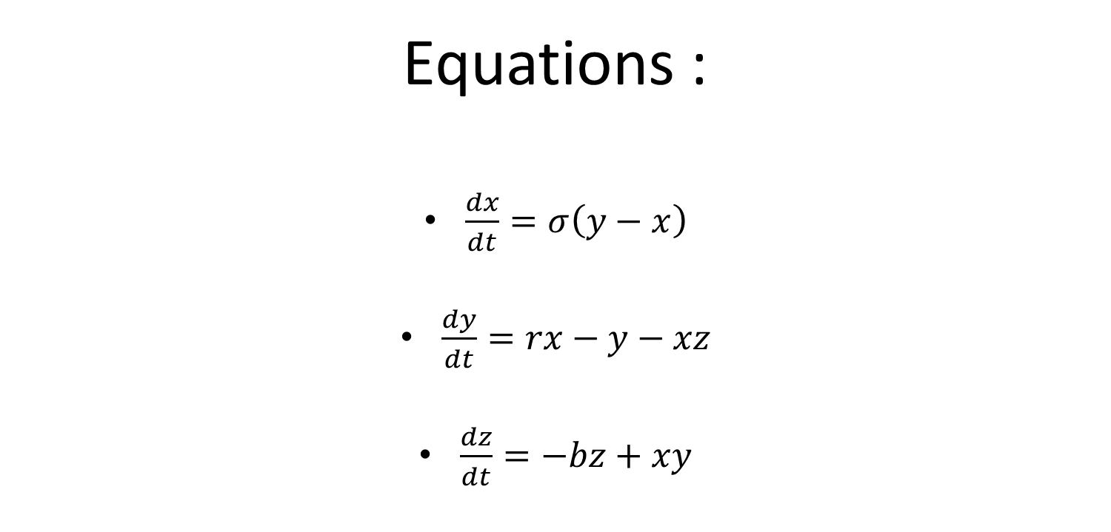
Lorenz System
Equations :
$\frac{dx}{dt}=σ\left(y−x\right)$
$\frac{dy}{dt}=rx−y−xz$
$\frac{dz}{dt}=−bz+xy$

Slide 2
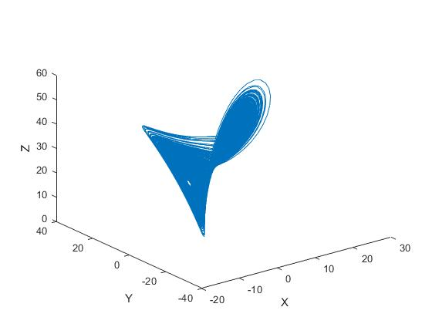
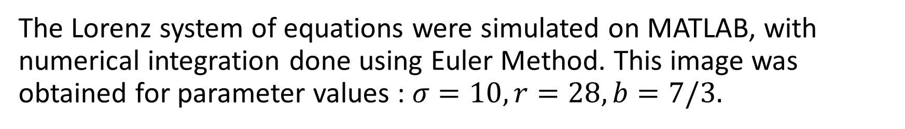
The Lorenz system of equations were simulated on MATLAB, with numerical integration done using Euler Method. This image was obtained for parameter values : $σ=10, r=28, b=7/3.$

Slide 3

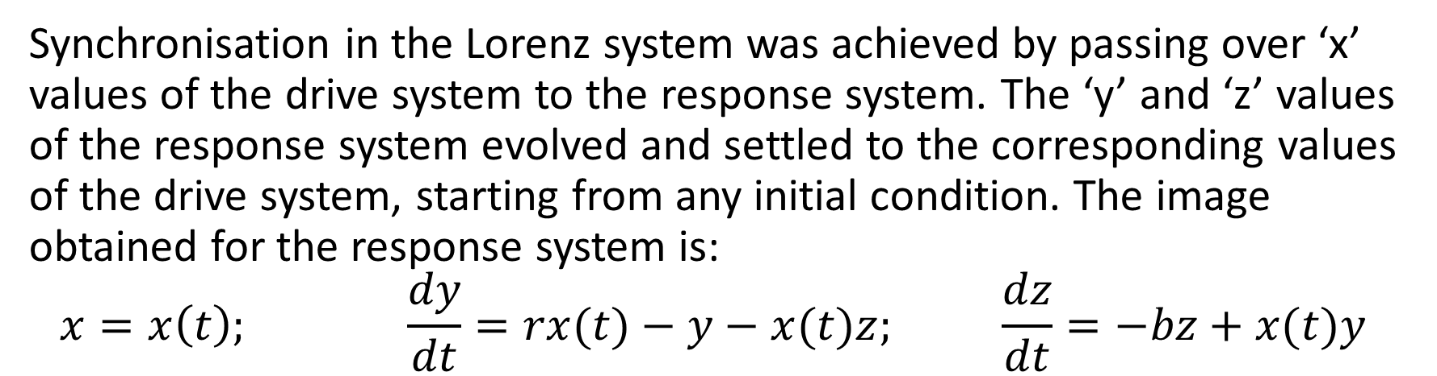
Synchronisation in the Lorenz system was achieved by passing over ‘x’ values of the drive system to the response system. The ‘y’ and ‘z’ values of the response system evolved and settled to the corresponding values of the drive system, starting from any initial condition. The image obtained for the response system is:
$$x=x\left(t\right); \frac{dy}{dt}=rx(t)−y−x(t)z; \frac{dz}{dt}=−bz+x(t)y$$

Slide 4
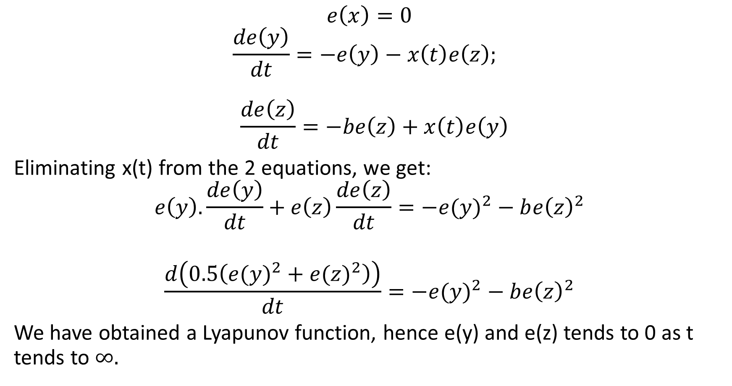
Proof of synchronisation
$$e\left(x\right)=0$$
$$\frac{de\left(y\right)}{dt}=−e\left(y\right)−x\left(t\right)e\left(z\right);$$
$$\frac{de\left(z\right)}{dt}=−be\left(z\right)+x\left(t\right)e\left(y\right)$$
Eliminating x(t) from the 2 equations, we get:
$$e\left(y\right).\frac{de\left(y\right)}{dt}+e\left(z\right)\frac{de\left(z\right)}{dt}={−e(y)}^{2}−b{e\left(z\right)}^{2}$$
$$\frac{d\left(0.5\left({e(y)}^{2}+{e(z)}^{2}\right)\right)}{dt}={−e(y)}^{2}−b{e\left(z\right)}^{2}$$
We have obtained a Lyapunov function, hence e(y) and e(z) tends to 0 as t tends to $∞.$

Slide 5
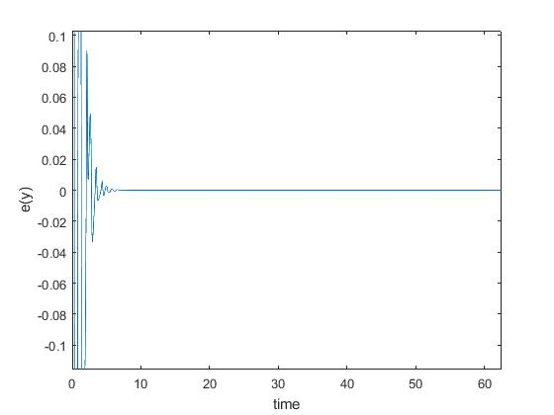
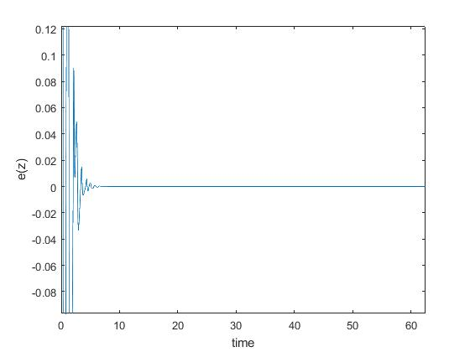
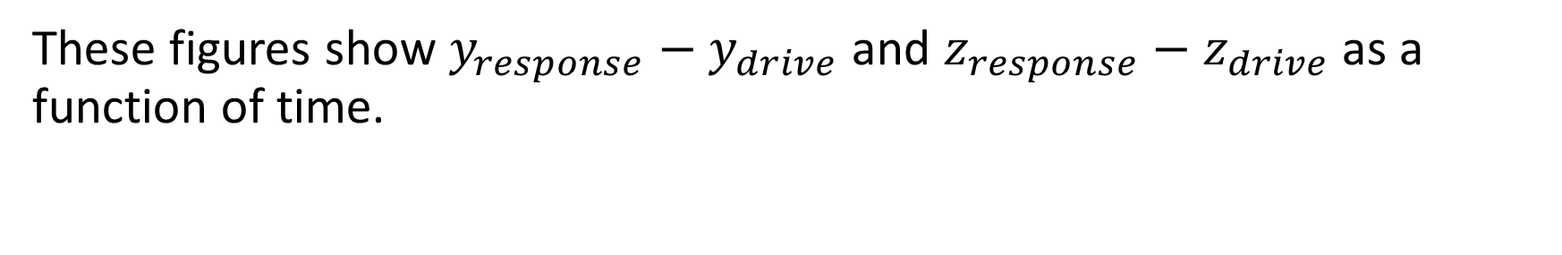
These figures show $y_{response}−y_{drive}$ and $z_{response}−z_{drive}$ as a function of time.

Slide 6
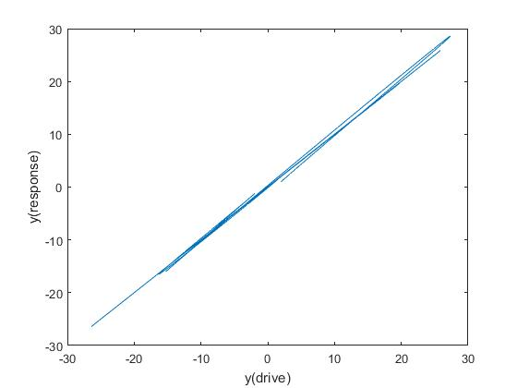
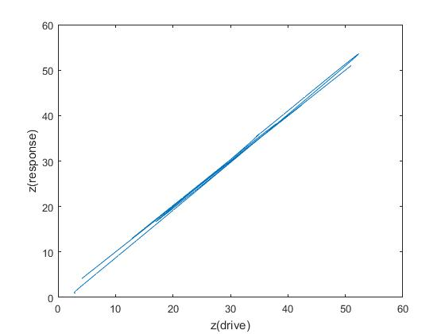
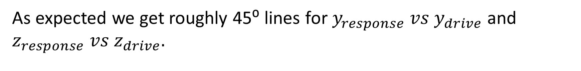
As expected we get roughly 45⁰ lines for $y_{response} vs y_{drive}$ and $z_{response} vs z_{drive}.$

Slide 7
Transmission of bit pulse
An input bit pulse can be generated in the drive system by modifying the values of parameter ‘b’. However the response system uses a single value of ‘b’. The x values of drive system is subtracted from x values of chaos system and then interpreted as 0’s and 1’s.

Slide 8
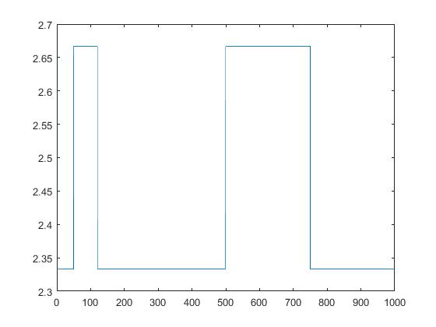
This is the input bit pulse generated using the values of b: 7/3 and 8/3.
The response system uses value 7/3 throughout.

Slide 9
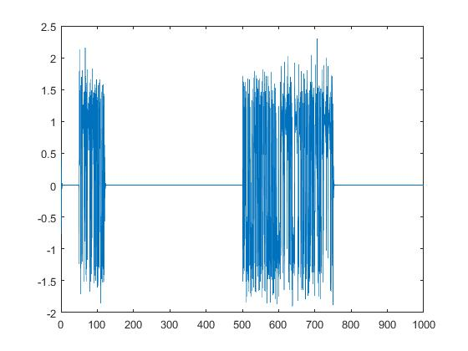
This is the output generated at the response system. The “flat zero” region is interpreted as binary value 0 and the chaotic region is interpreted as binary value 1.

Slide 10
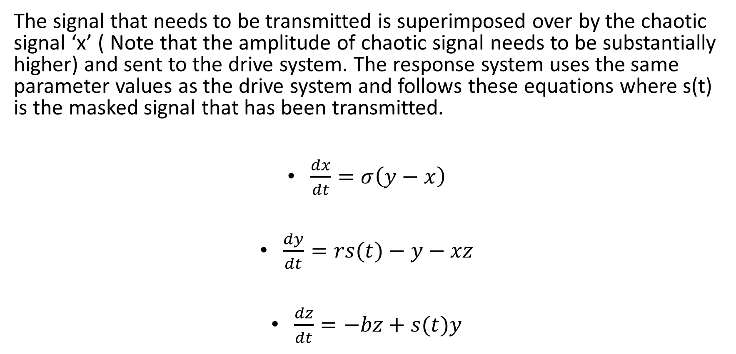
Transmission of signal
The signal that needs to be transmitted is superimposed over by the chaotic signal ‘x’ ( Note that the amplitude of chaotic signal needs to be substantially higher) and sent to the drive system. The response system uses the same parameter values as the drive system and follows these equations where s(t) is the masked signal that has been transmitted.
$\frac{dx}{dt}=σ\left(y−x\right)$
$\frac{dy}{dt}=rs(t)−y−xz$
$\frac{dz}{dt}=−bz+s(t)y$

Slide 11
DEMO

